Slide 1


Intermittent Performance of Pilot Scale Off-Grid Nanofiltration System
2023 Arizona NASA Space Grant Statewide Symposium
Katelynn Carroll ª, Ailyn Brizo ^{b}, Mackenzie Bonney ^{b}, Hunter Gudenkauf ^{b}, Abby Haan ^{b}, Lauren Vasquez ª and Vasiliki Karanikola ^{b}
ª Department of Biosystems Engineering, University of Arizona, Tucson, AZ 85721, USA
^{b} Department of Chemical and Environmental Engineering, University of Arizona, Tucson, AZ 85721, USA

Slide 2
Background
Challenges facing communities in the Navajo Nation related to safe drinking water:
Low population density – centralized water treatment is not economically feasible
Unregulated groundwater wells – exceedances of primary drinking water contaminants, such as arsenic, uranium, and total dissolved solids (TDS)
Limited access to electricity – an estimated 32% of Navajo households lack access to electricity
Critical need to develop sustainable point-of-use treatment systems

Slide 3
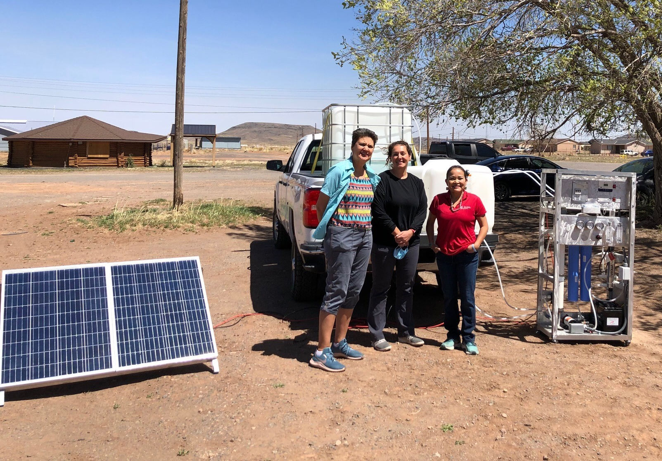
Project Objectives
Objectives
Determine community water quality
Develop an off-grid solar-powered nanofiltration system
Determine the effects of the intermittent operation on membrane performance
Feed Water
✓
Filtration System
✓
Solar Panel
Image of the off-grid solar-powered nanofiltration (SNF) system, featuring Dr. Jani Ingram, Dr. Vicky Karanikola, and Dr. Karletta Chief (left to right)
Notes:
Usually operated under continuous operation, however, when it’s paired with solar power, the system only operates during daylight hours

Slide 4
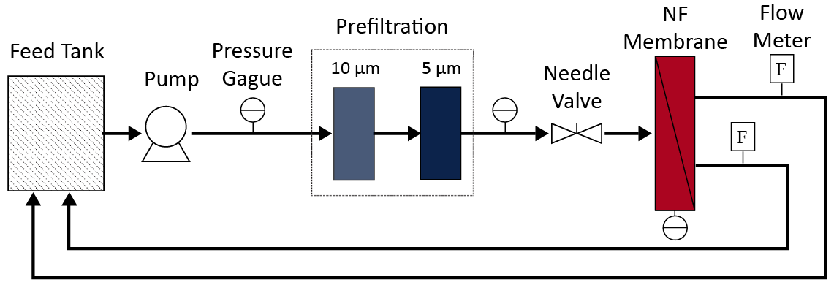
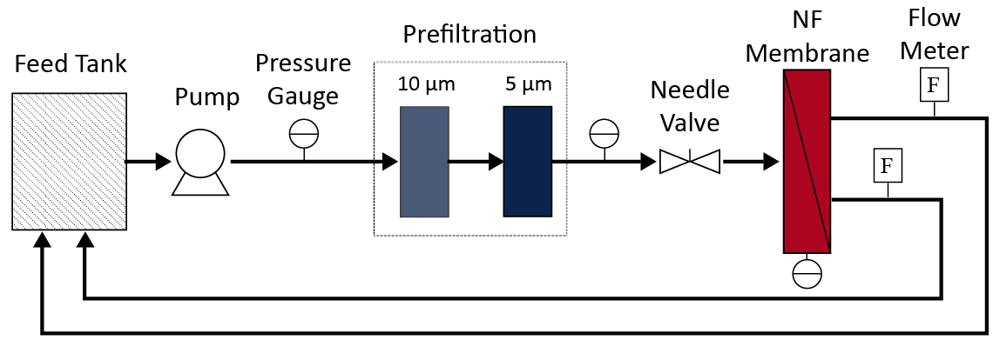
Research Filtration System

Slide 5
Research Filtration System
Suspended Particles
Multivalent Ions
Monovalent Ions
Water
Feed Water

Slide 6
Research Filtration System
Suspended Particles
Multivalent Ions
Monovalent Ions
Water
Feed Water
Prefiltration

Slide 7
Research Filtration System
Suspended Particles
Multivalent Ions
Monovalent Ions
Water
Feed Water
Prefiltration
Nanofiltration

Slide 8
My Research
Objective: Determine the effects of intermittent operation on membrane performance
However…
In research, everything that can go wrong will go wrong.
Notes:
Troubleshooting and replacements, it’s research so everything that can, will go wrong, lessons learned

Slide 9
Troubleshooting

Slide 10
Finally… Experiments
Create a synthetic water representative of waters found on the Navajo Nation
Run the system intermittently – 5 hours a day, 5 days a week
Analyze samples – ion chromatography (IC) and total organic carbon analysis (TOC)
Interpret results
Notes:
Determine the effects of intermittent operation on membrane fouling

Slide 11
Results
Rejection By Size
Most rejection took place through the NF membrane
Prefilters
NF
Suspended Particles
13.9%
55.0%
Multivalent Ions
-7.2%
13.8%
Monovalent Ions
78.2%
-6.1%
Hour

Slide 12
Results
Rejection By Size
Most rejection took place through the NF membrane
Day-to-day, the intermittent operation had minor impacts the system overcame
Prefilters
NF
Suspended Particles
13.9%
55.0%
Multivalent Ions
-7.2%
13.8%
Monovalent Ions
78.2%
-6.1%
Hour

Slide 13
Results
Rejection By Size
Most rejection took place through the NF membrane
Day-to-day, the intermittent operation had minor impacts the system overcame
Extended periods of downtime lead to reversible fouling
Prefilters
NF
Suspended Particles
13.9%
55.0%
Multivalent Ions
-7.2%
13.8%
Monovalent Ions
78.2%
-6.1%
Hour

Slide 14
Key Takeaways
Material selection is critical
Rejection takes place in the NF membrane
Extended periods of downtime lead to reduced performance but is reversible
Daily intermittent operation does not have severe impacts on membrane performance

Slide 15
Key Takeaways
Material selection is critical → materials can corrode
Rejection takes place in the NF membrane → prefilter replacement may not extend the lifetime
Extended periods of downtime lead to reduced performance but reversible membrane performance → downtime is not disastrous
Daily intermittent operation does not have severe impacts on membrane performance→ intermittent operation does not severely reduce performance

Slide 16
Thank you!
To the Space Grant program coordinators, mentors, student advisors, and fellow interns! Everyone in the KORES lab, especially Abby and Lauren for their help in the lab and Chris, Jack, and Arianna for their guidance. And my wonderful advisor, Vicky, for continued support and mentorship over the last four years.

